Slide 1
Predicting Bipolar Disorder using IPA as measured by minipons
Kevin Yie

Slide 2
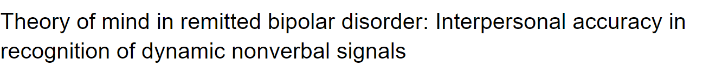
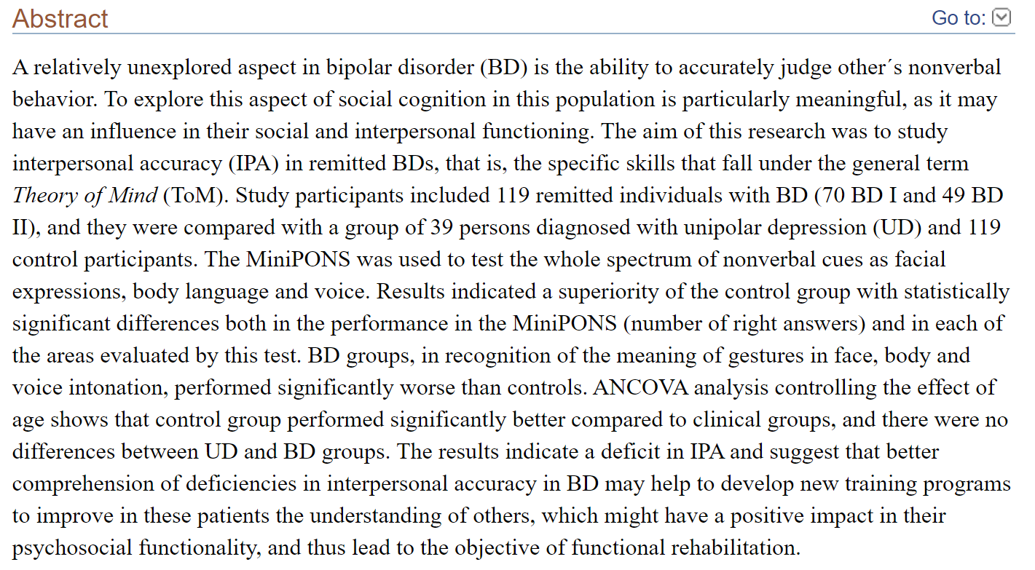
Background

Slide 3
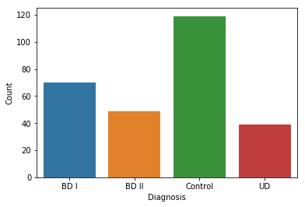
Descriptive Statistics
267 entries with 12 attributes
Right answers, Audio Prosody, Combined Channel, Face video, Body Video, Positive Valence, Negative Valence, Dominant, Submissive
2 labeled attributes (One differentiating between BP I and BP II, One without)

Slide 4
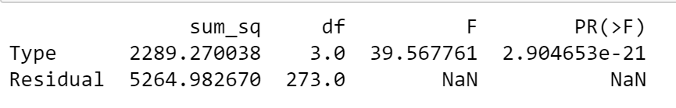
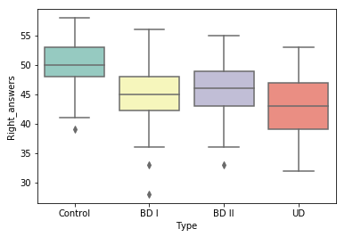
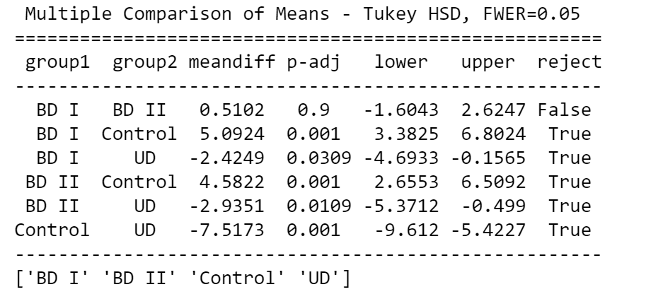
Anova for correct answers by disorder type
Examined which variables showed differences between groups

Slide 5
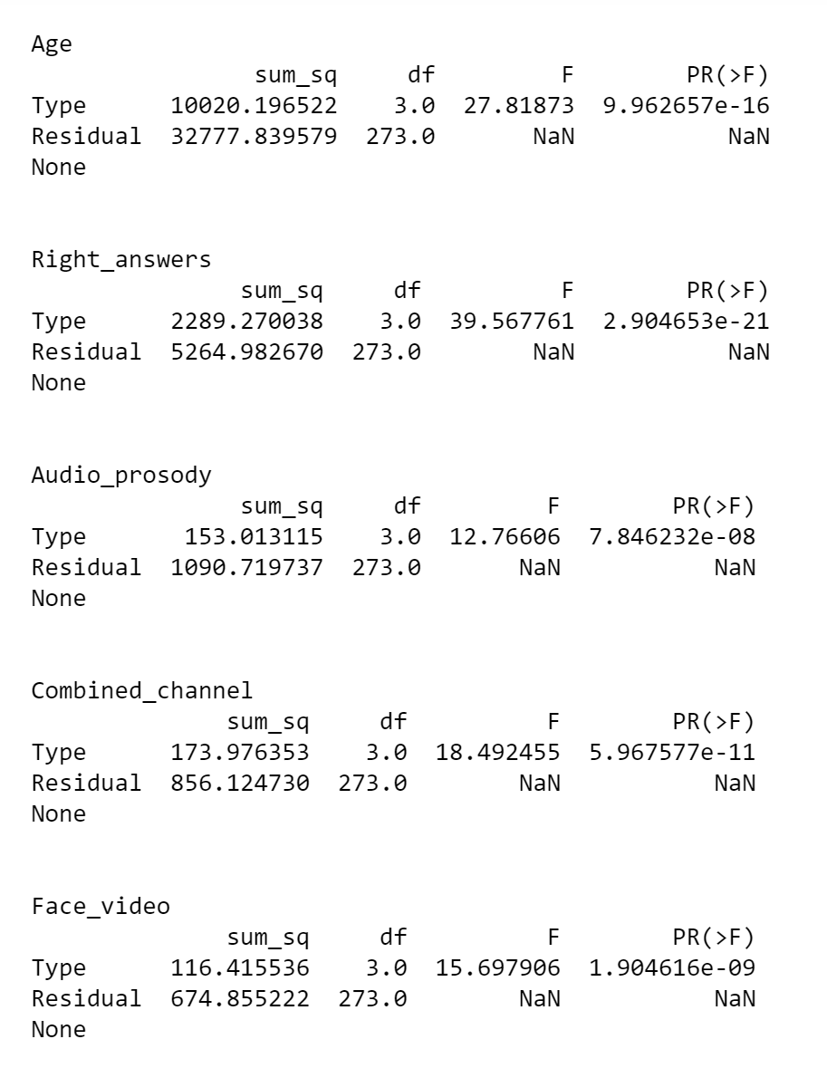
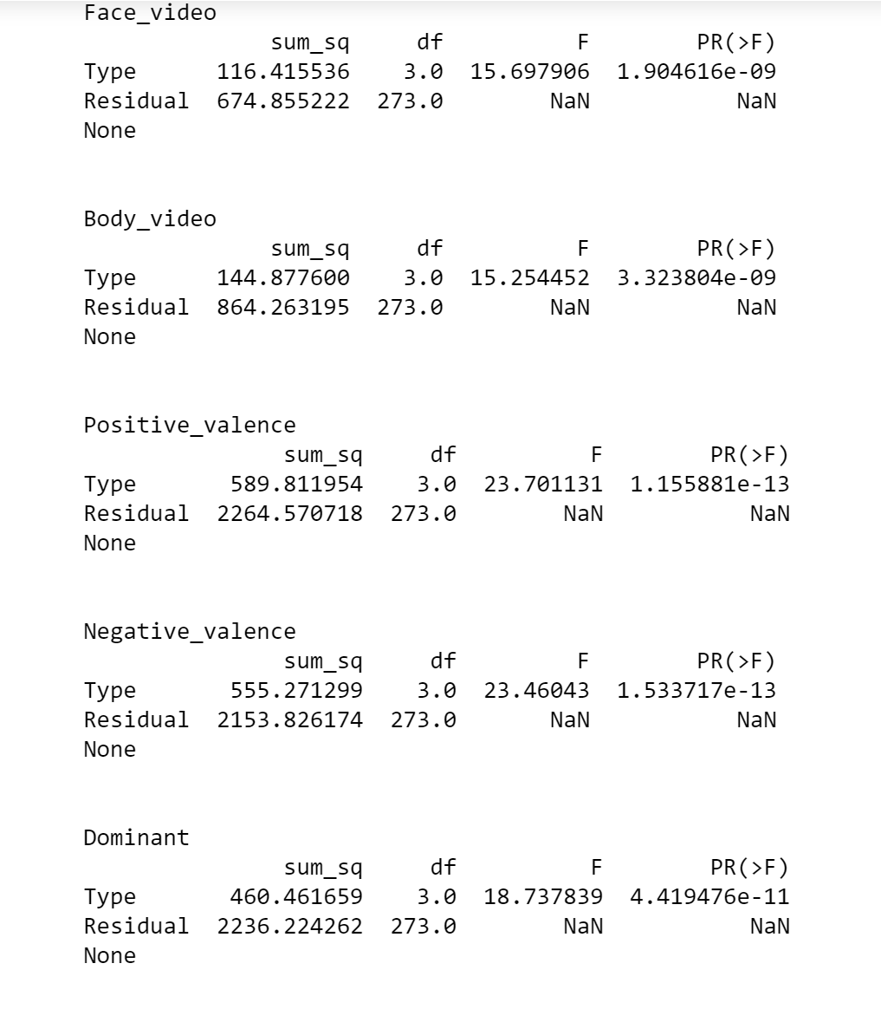
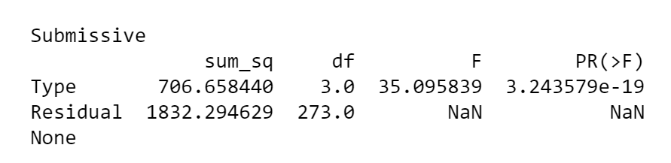
Anova for all features

Slide 6
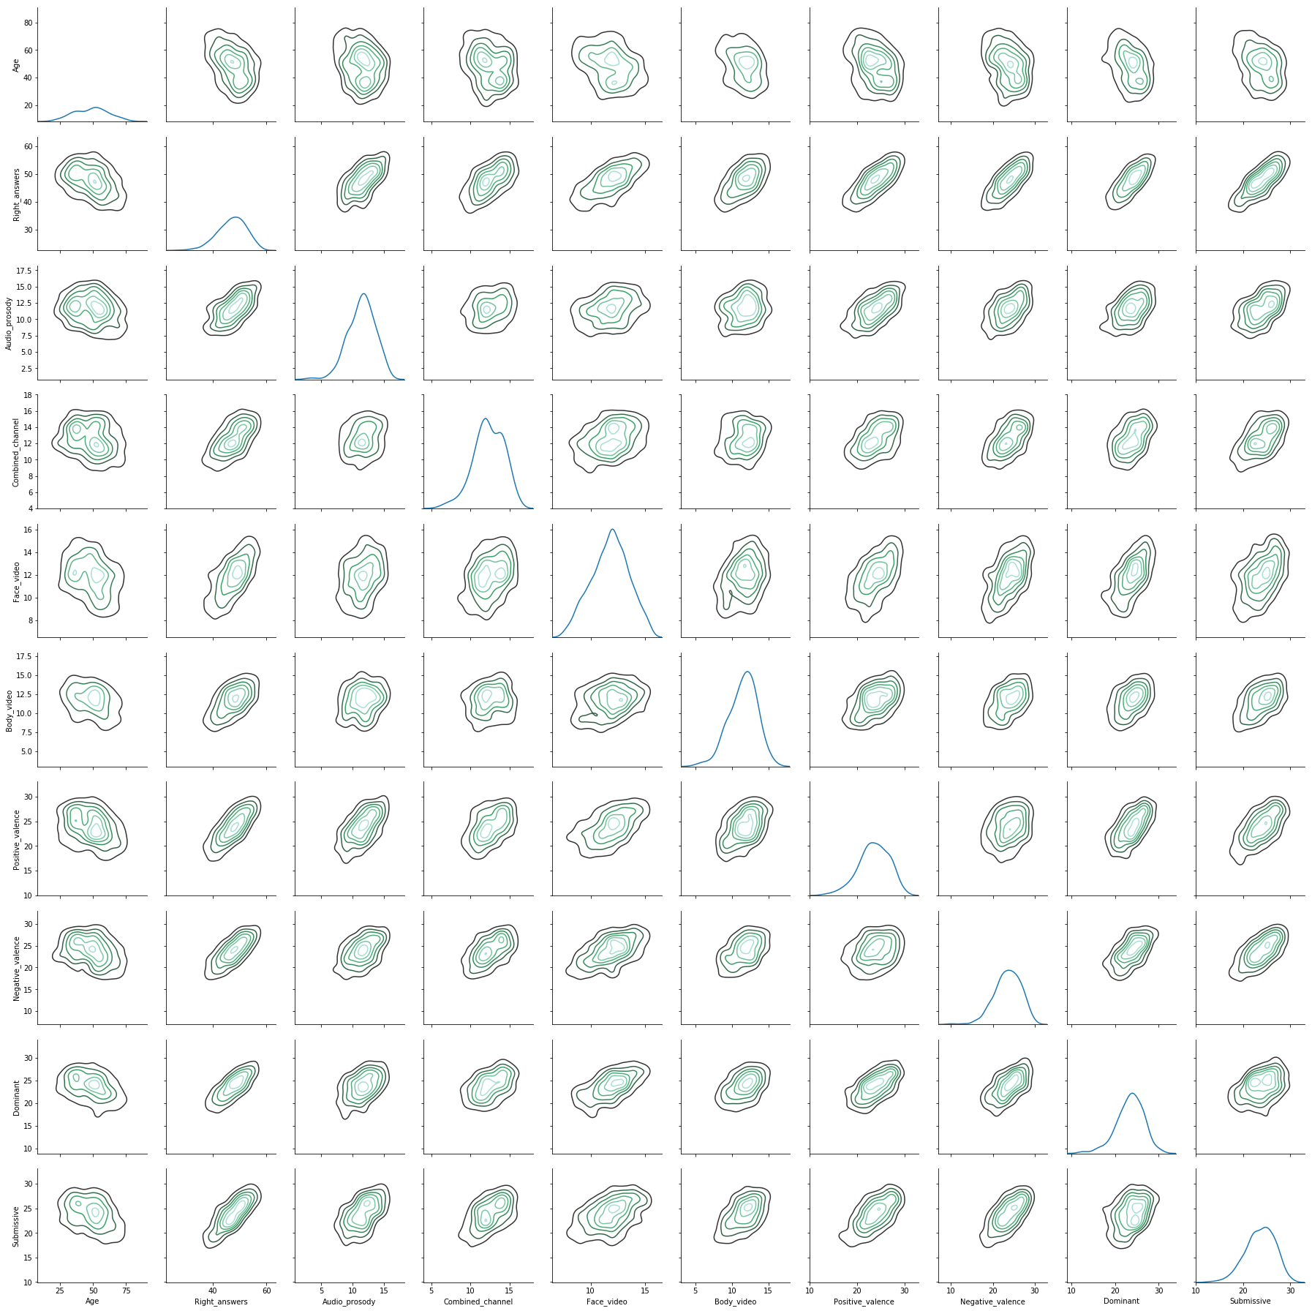
Distribution of features
Problems arise
The diagonals show distribution of the variables
All variables appear to be normally distributed
We want underlying class distributions to be different
Given that there are no class imbalances between BP and Control, we wanted to see 2 peaks. 3 would be even better
Optimally, we want to 2 clusters form from the KDE plots which would tell use which variables were best at separating classes

Slide 7
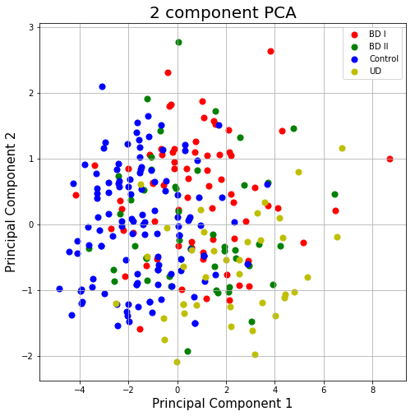
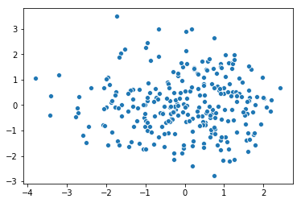
Searching for Clusters
Left plot: LDA
LDA based on 4 classes returns no clear clusters
Right plot: PCA
PCA shows a lot of overlay of data

Slide 8
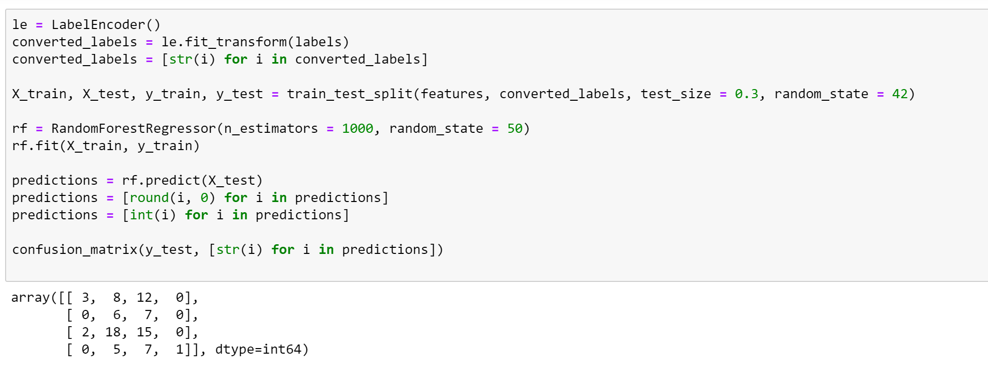
Quick test of multiclass Prediction in Random Forest

Slide 9
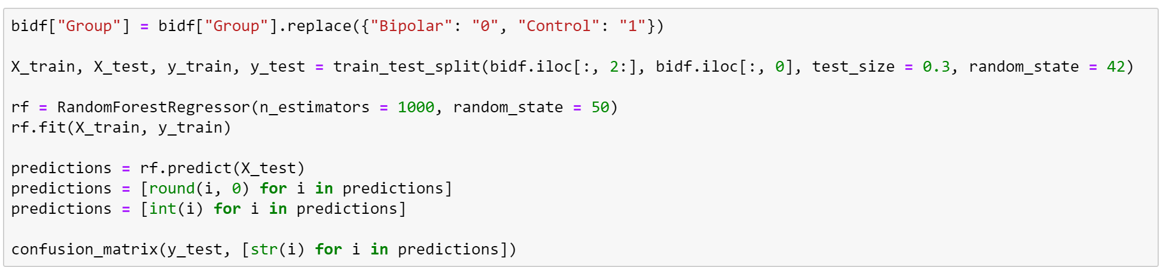
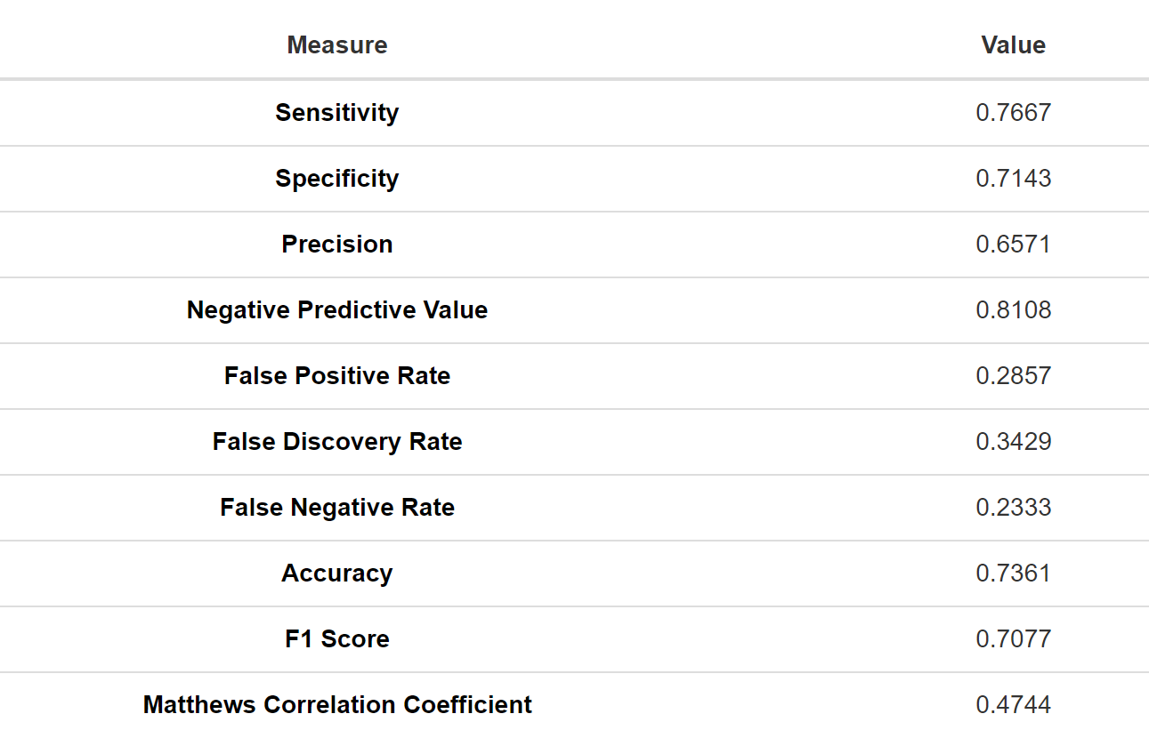
Binary Classification Models (Control vs. BP)

Slide 10
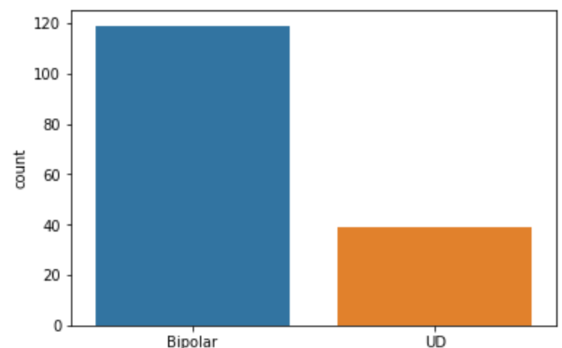
Binary Classification Models (BP vs UD)

Slide 11
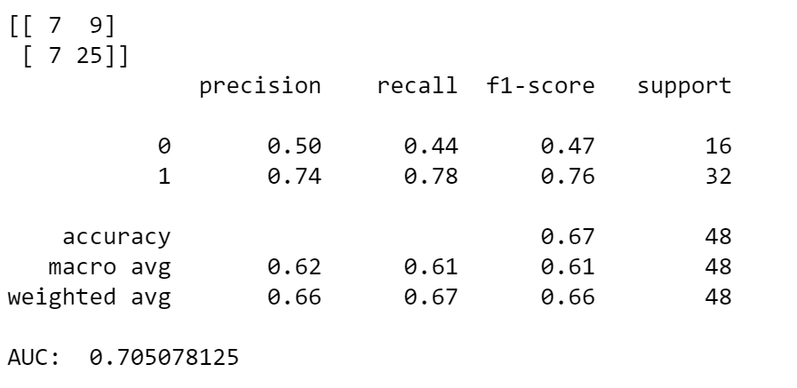
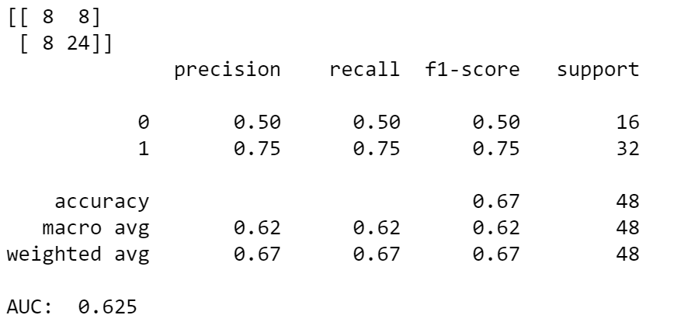
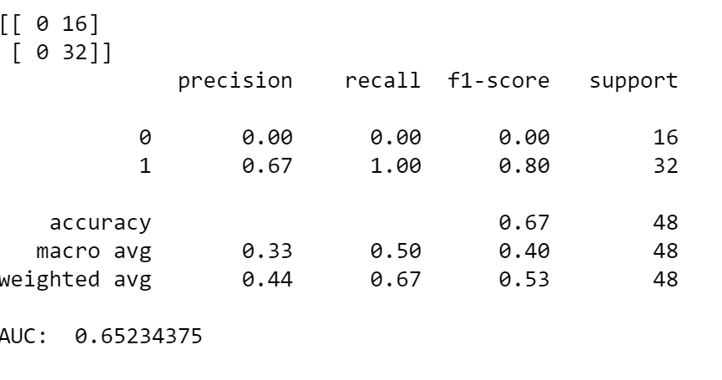
Simple Model Comparisons
Random Forest
KNN
SVM

Slide 12
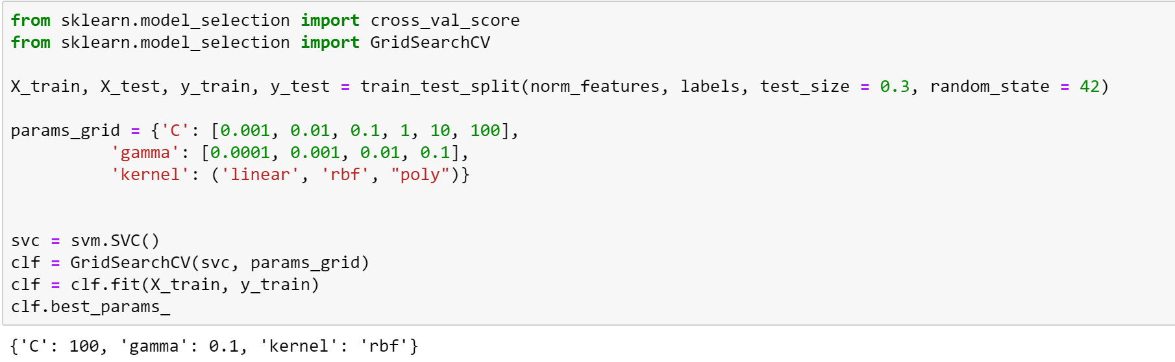
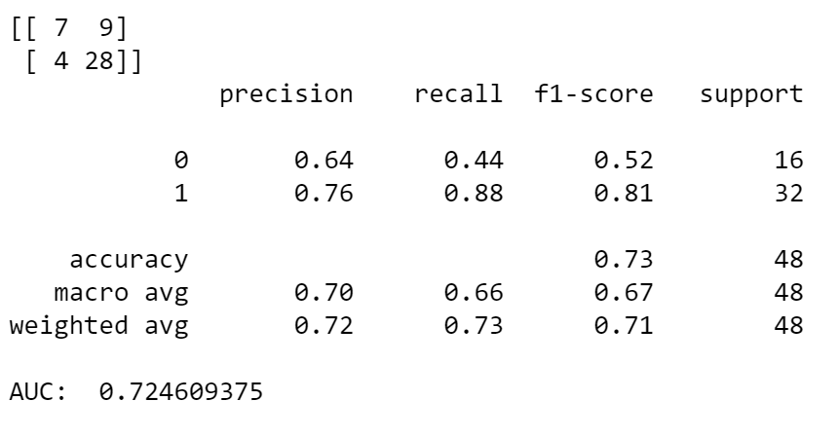
Hyperparameter Tuning for svm

Slide 13
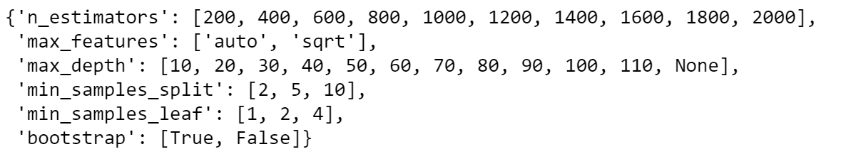
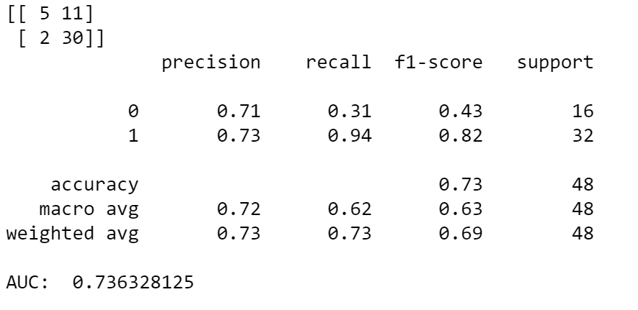
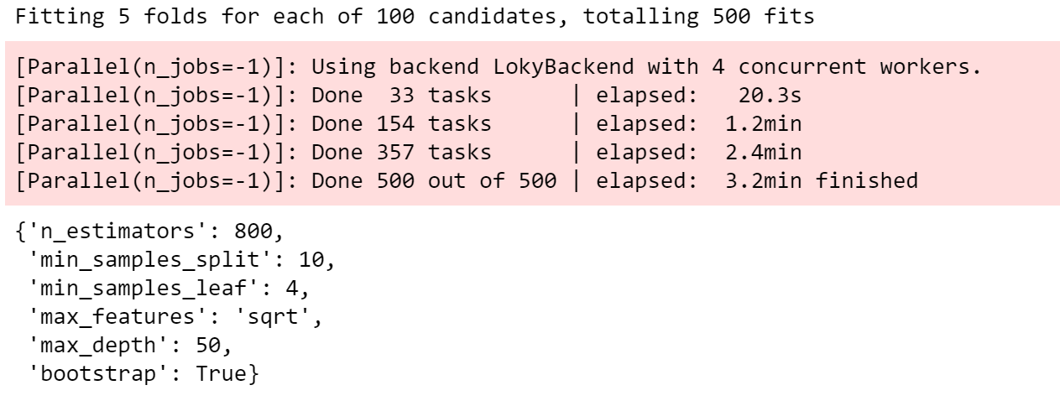
Hyperparameter tuning for Random Forest

Slide 14
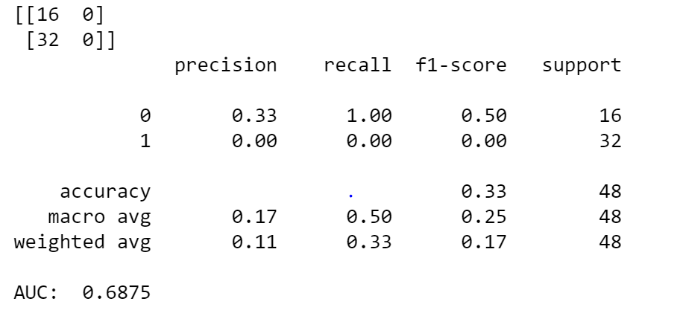
Hyperparameter tuning For Neural Net

Slide 15



Takeaways and future direction
Clinical Significance
miniPONS, by itself with limited data, is not enough to predict the difference between BP and UD
More datapoints would potentially help
12% of BD misdiagnosed in SVM vs.
Machine Learning takeaways
Scaling and normalization can sometimes lead to worse performance (likely due to limited sample size)
Although powerful in its base state, Random Forest’s ability to improve power isn’t as high as some other models
AUC, or any single index, is not enough to judge a model
Future Directions
Balance the dataset
Find a class weight for SVM that leads to better separation
Increase NN size

